Slide 1

Doggie App
By Noa Binenbaum and Alex Dashevski
Guided by Roman Kaplan

Slide 2
Goals
Bring dogs’ owners together for playing meetings
Provide user experience as good as possible
Choosing the most suitable dogs for best matches
Contact dogs’ owners through the app

Slide 3
Methodology
Environment: Android development using Java on Android Studio IDE
Implementation:
Building an end-to-end system where a client application will be implemented on a smart phone
Using Google Firebase framework to authenticate users, store their data with real-time database and file storage
Using Google maps services to present online users on map

Slide 4
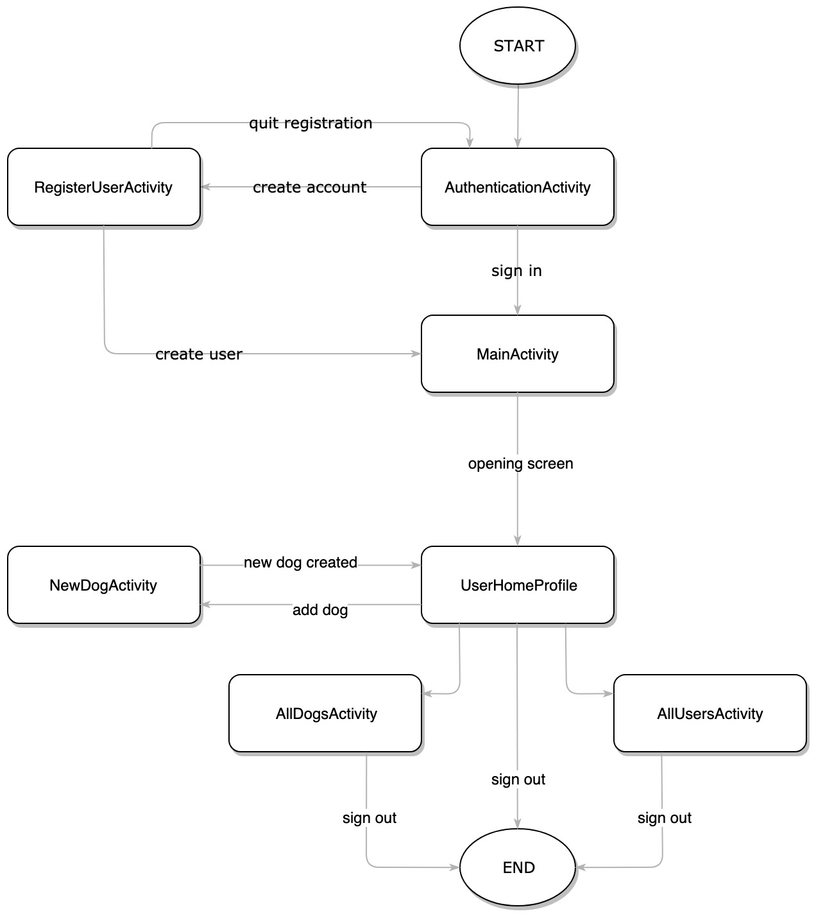
System Block Diagram

Slide 5
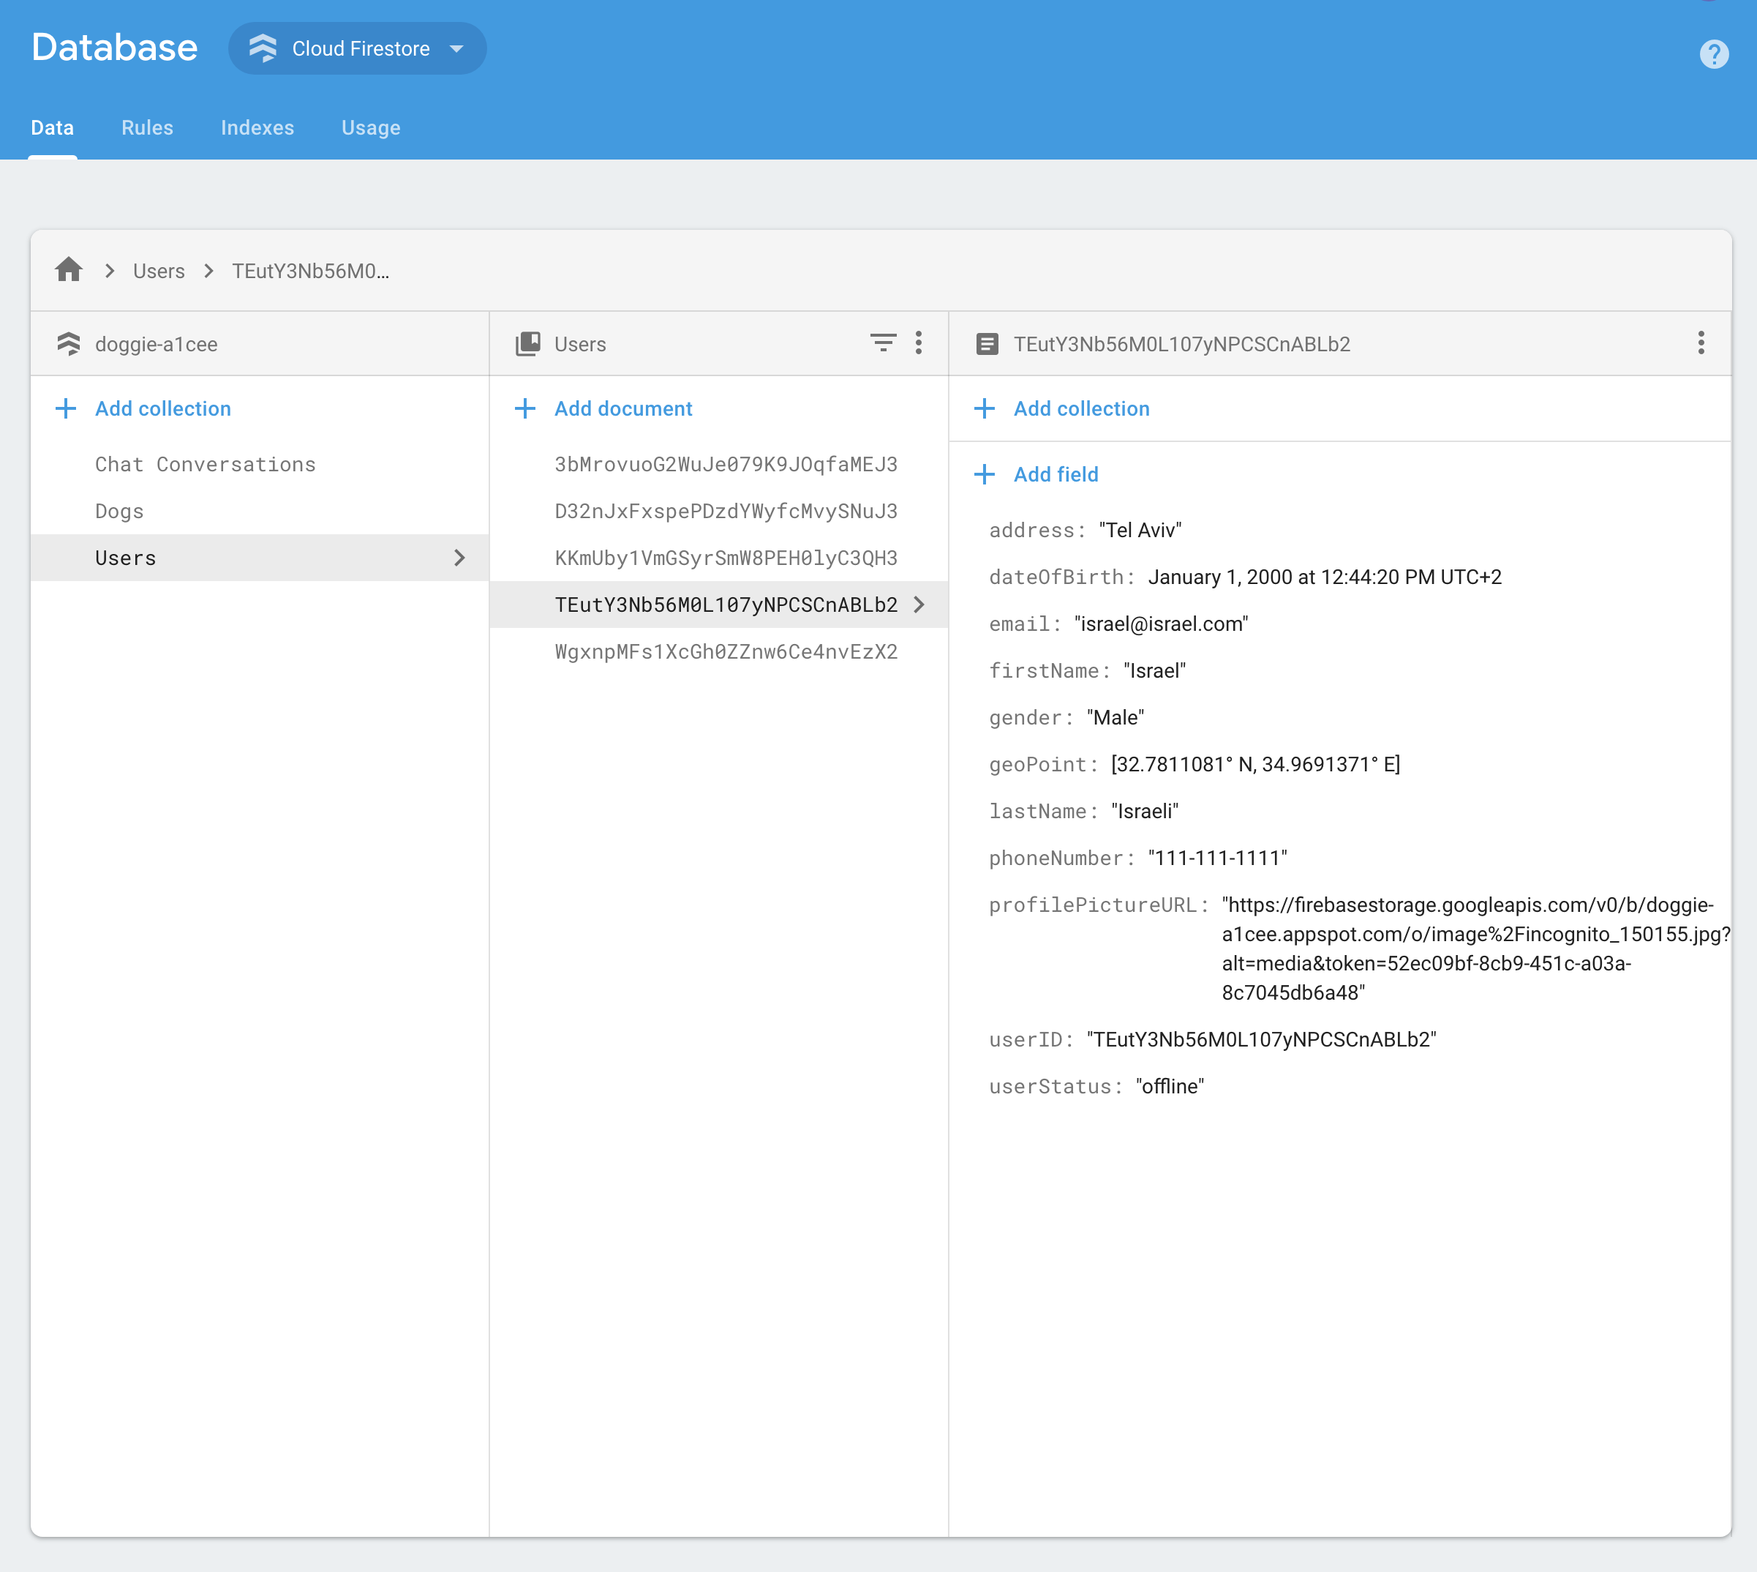
Client – Server
Communication is carried out through Firebase API Platform
Code written in Java
Data structures:
Users
Dogs
Chat Conversations

Slide 6
Client – Server
Server Side
Registration
Authentication
Database
Storage
Client Side
Calculate distance between users
Manage users’ status
Create new dogs
Query and display:
Users on map
Chat conversations
Registered dogs
Users’ profile

Slide 7
Database
Cloud Firestore is a cloud-hosted, NoSQL database
Data is stored in documents that contain fields mapping to values
Documents are stored in collections and are used for organizing data and building queries
Documents support many different data types

Slide 8
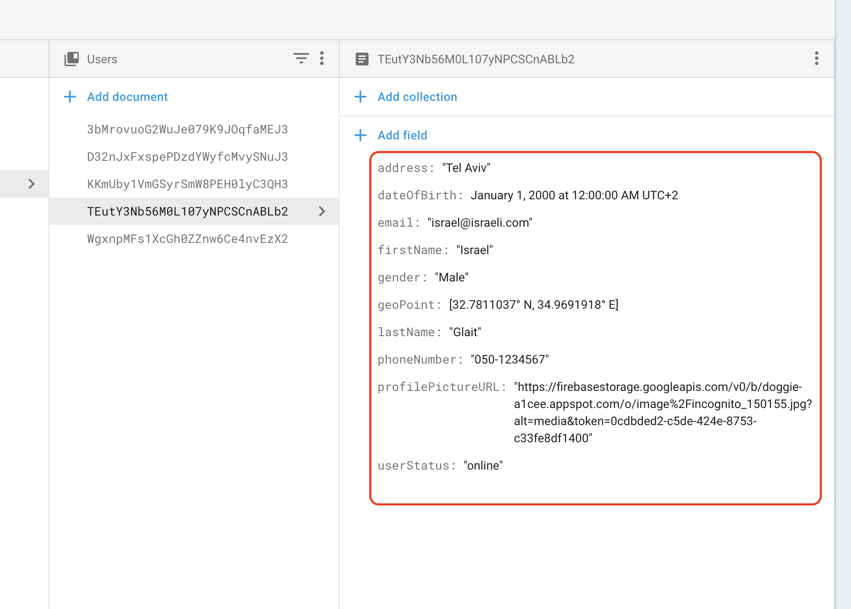
Database – Users
Full name
Profile picture
Email address
Last known location
Status
Optional fields:
Gender
Phone number
Address
Birthday

Slide 9
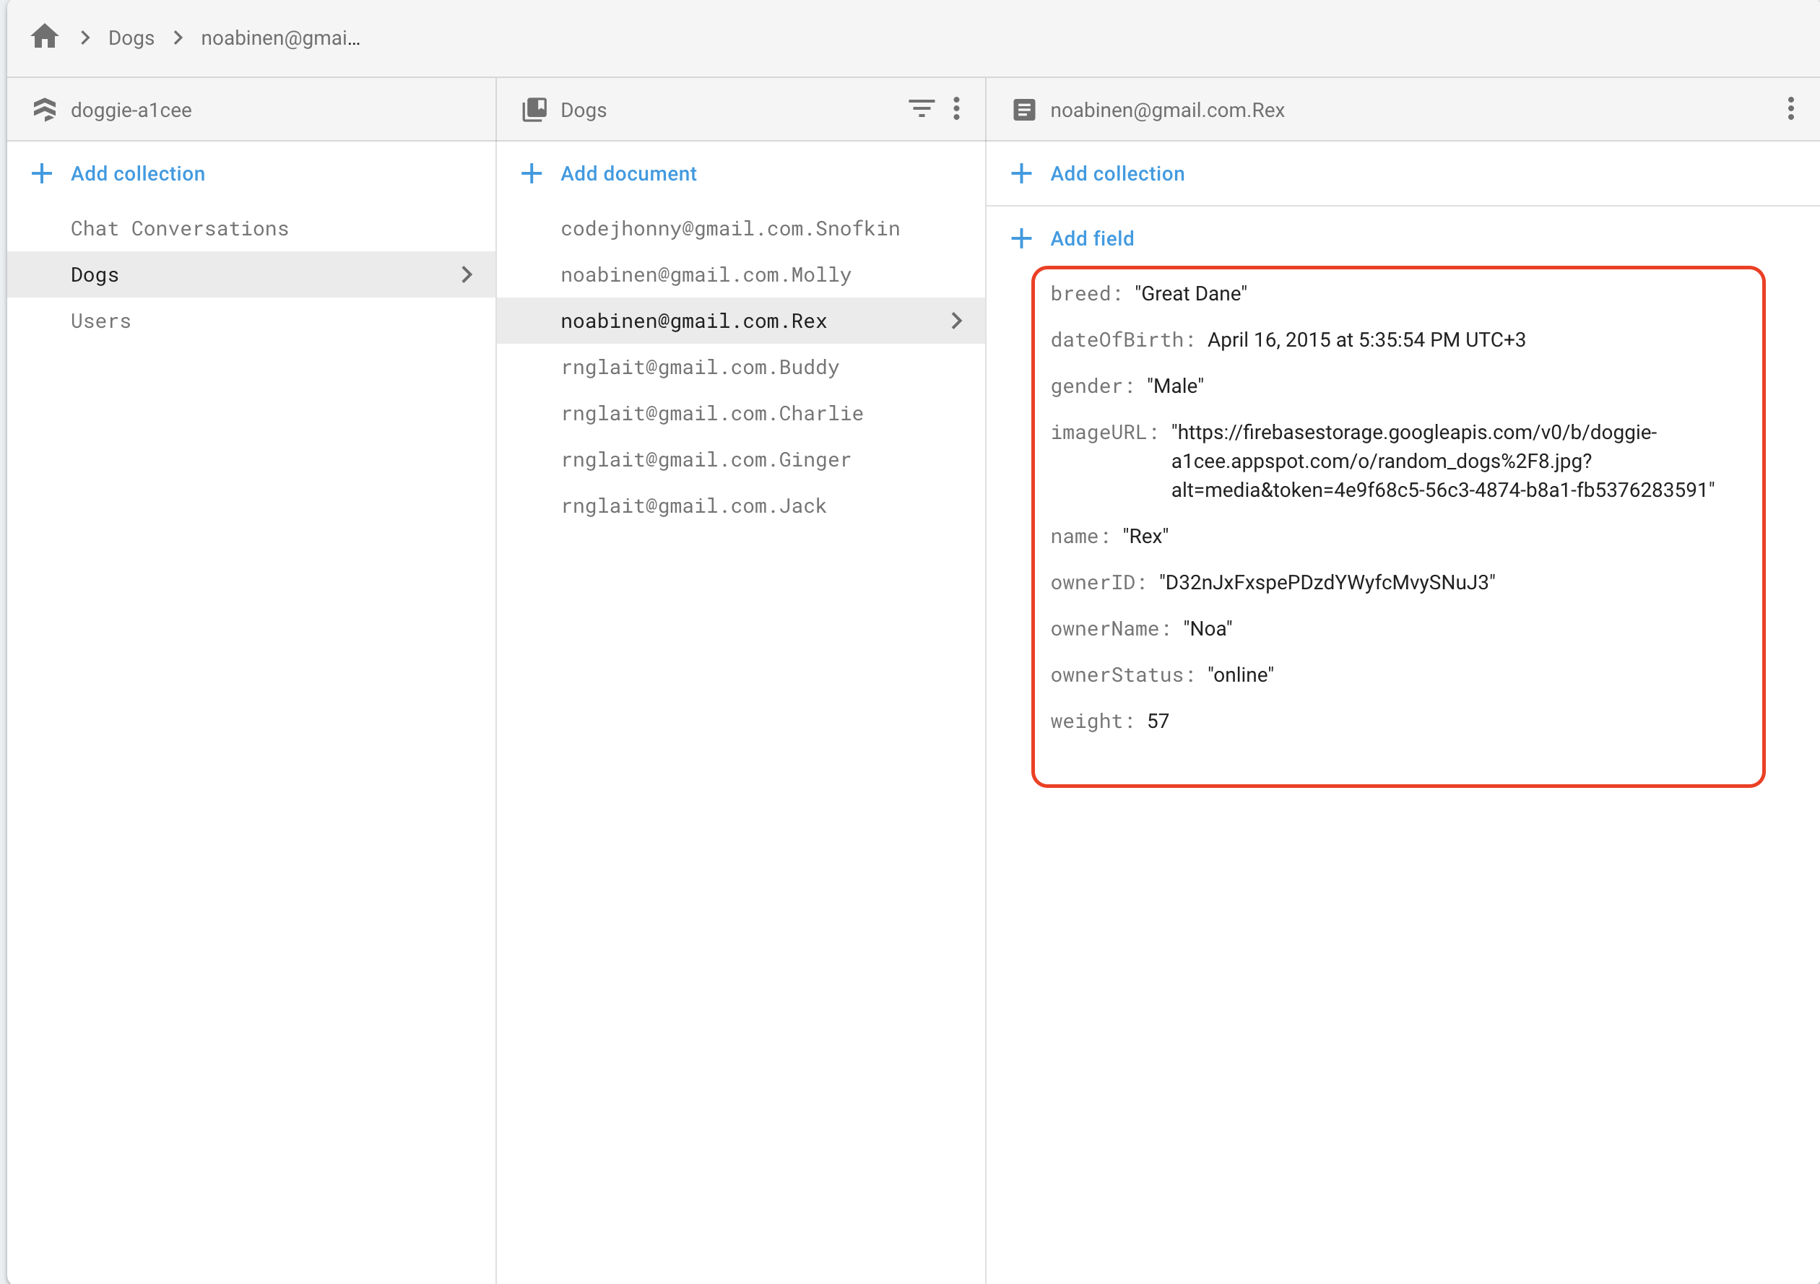
Database – Dogs
Name
Owner ID
Profile picture
Filtering fields:
Breed
Gender
Status
Birthday
Weight

Slide 10
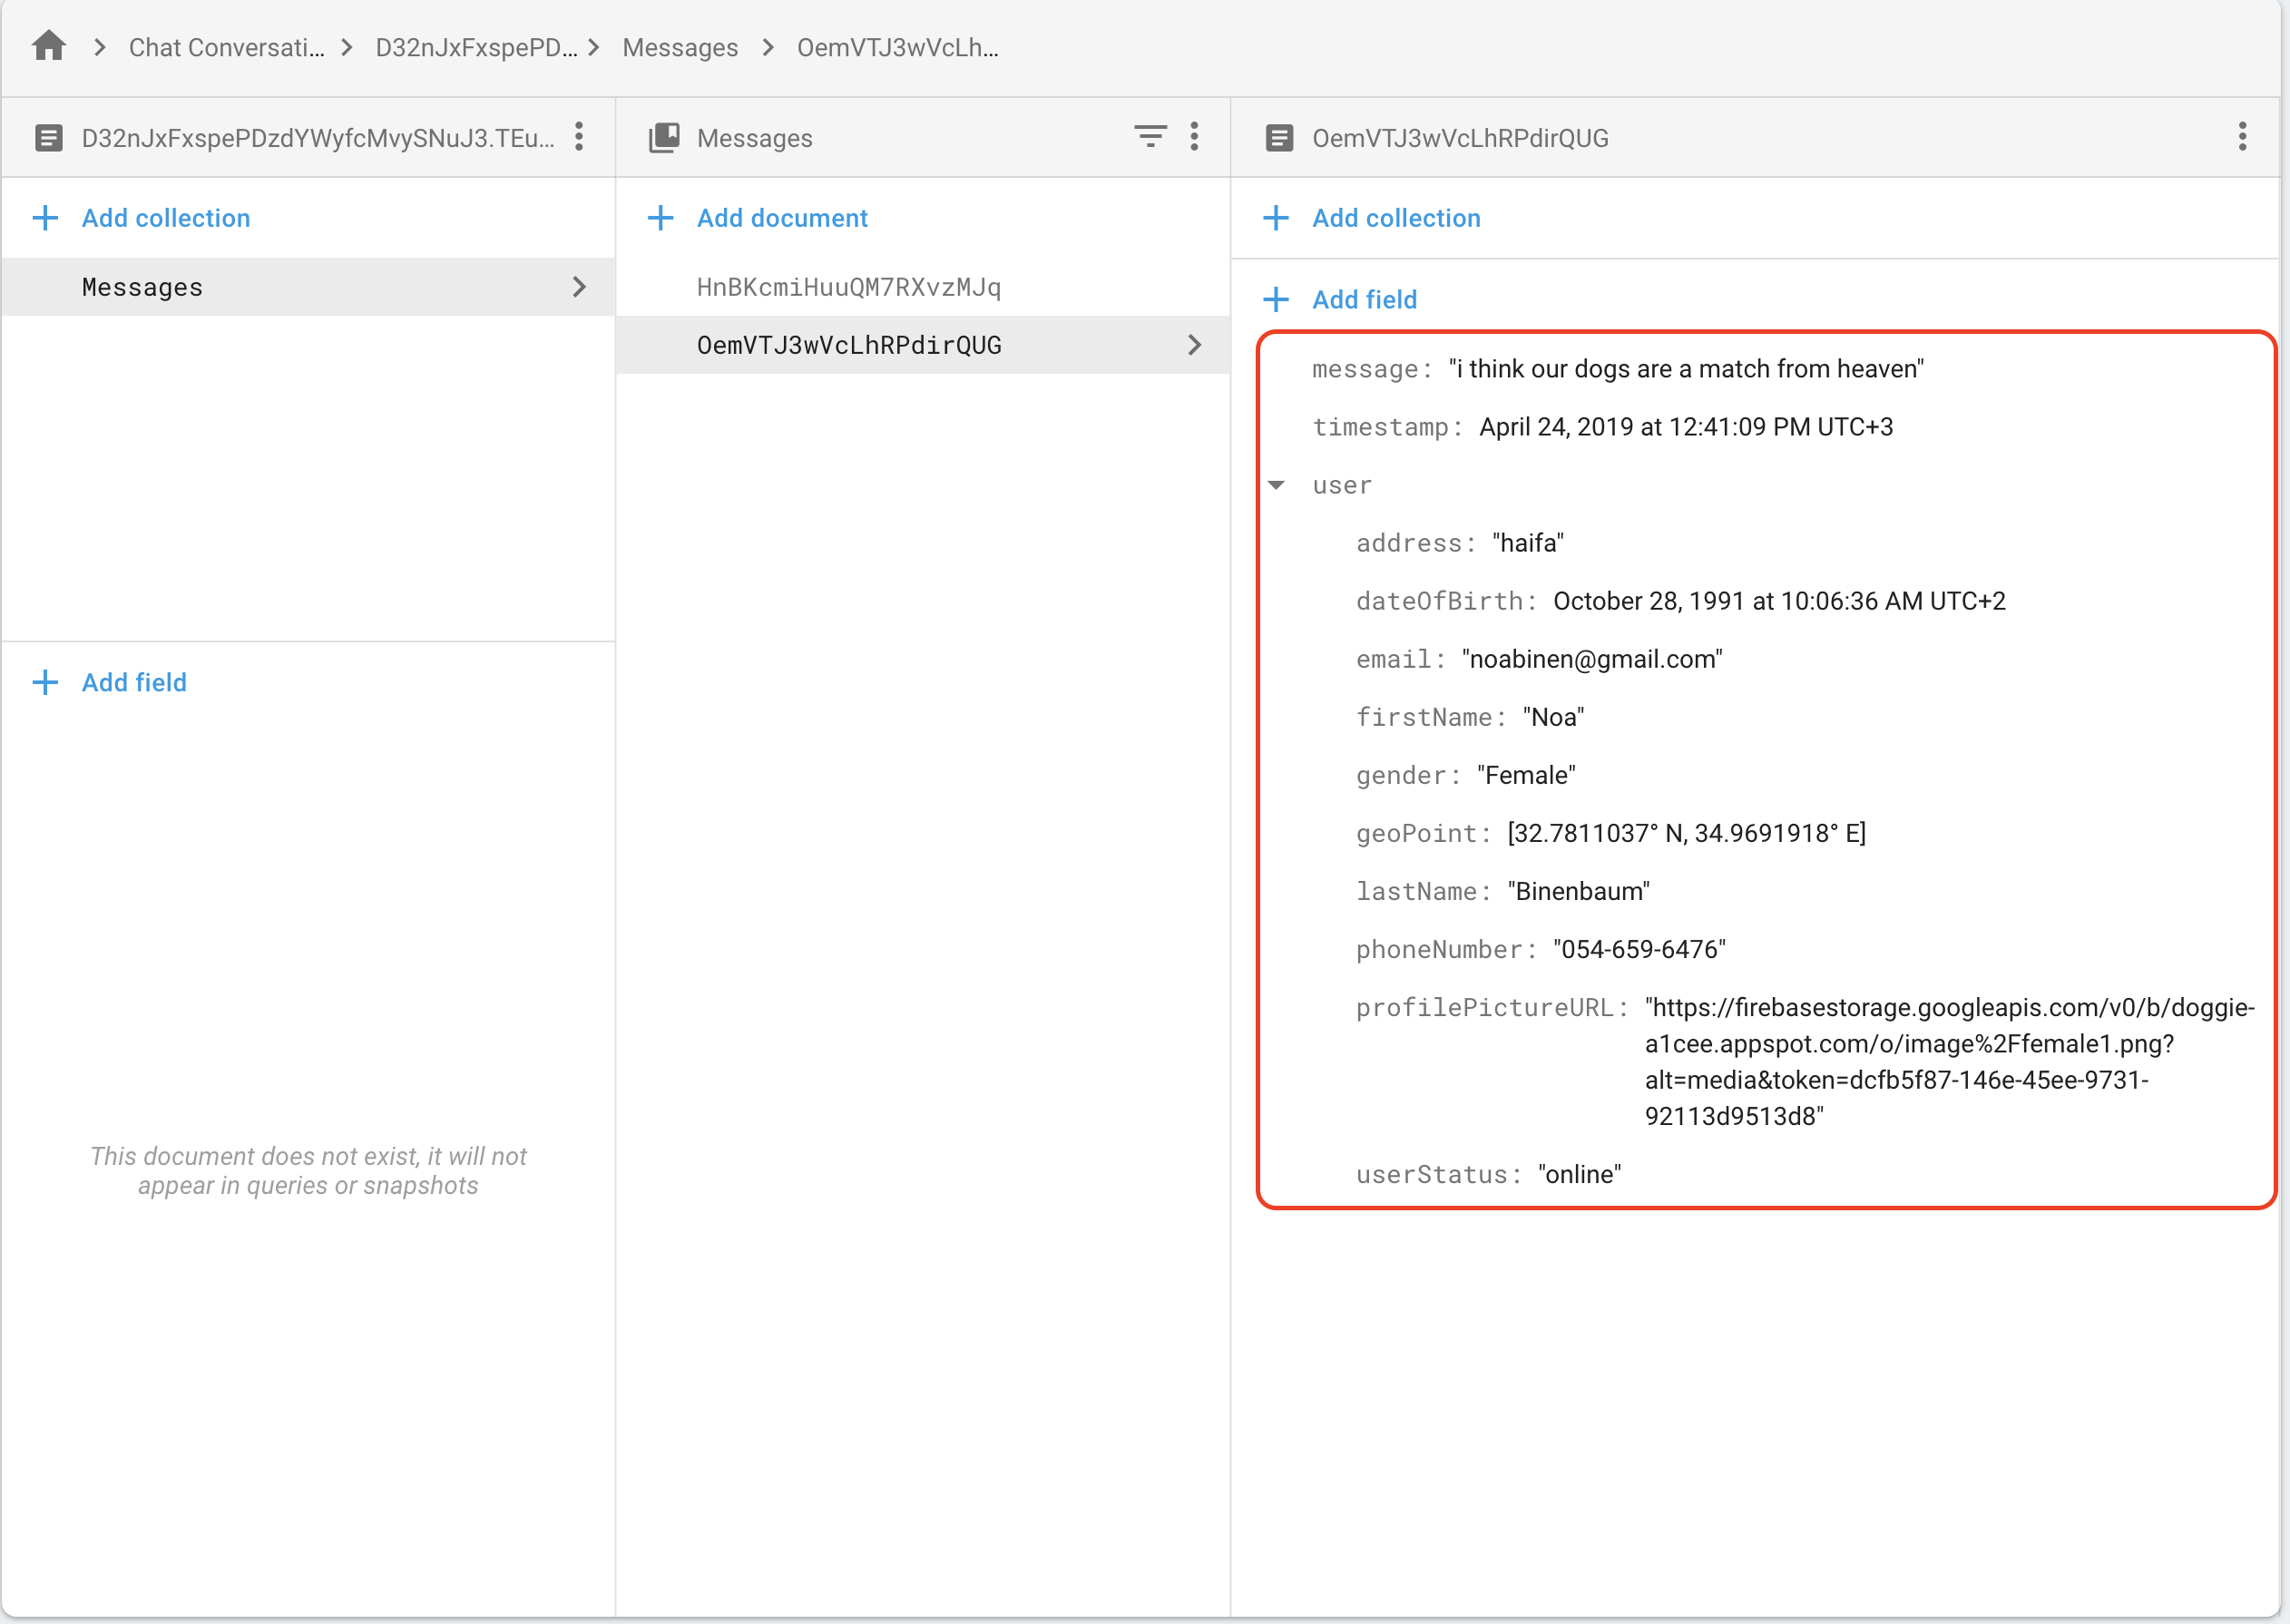
Database – Chat Conversations
Each conversation between two users is a new document
Messages are stored in a nested collection
Message fields are:
Content
Time stamp
Sender details (user reference)

Slide 11
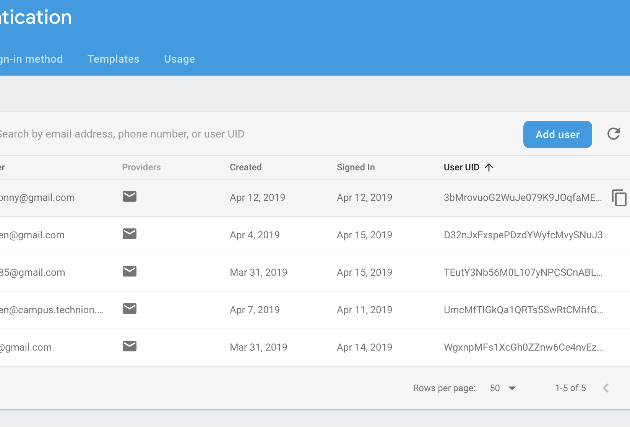
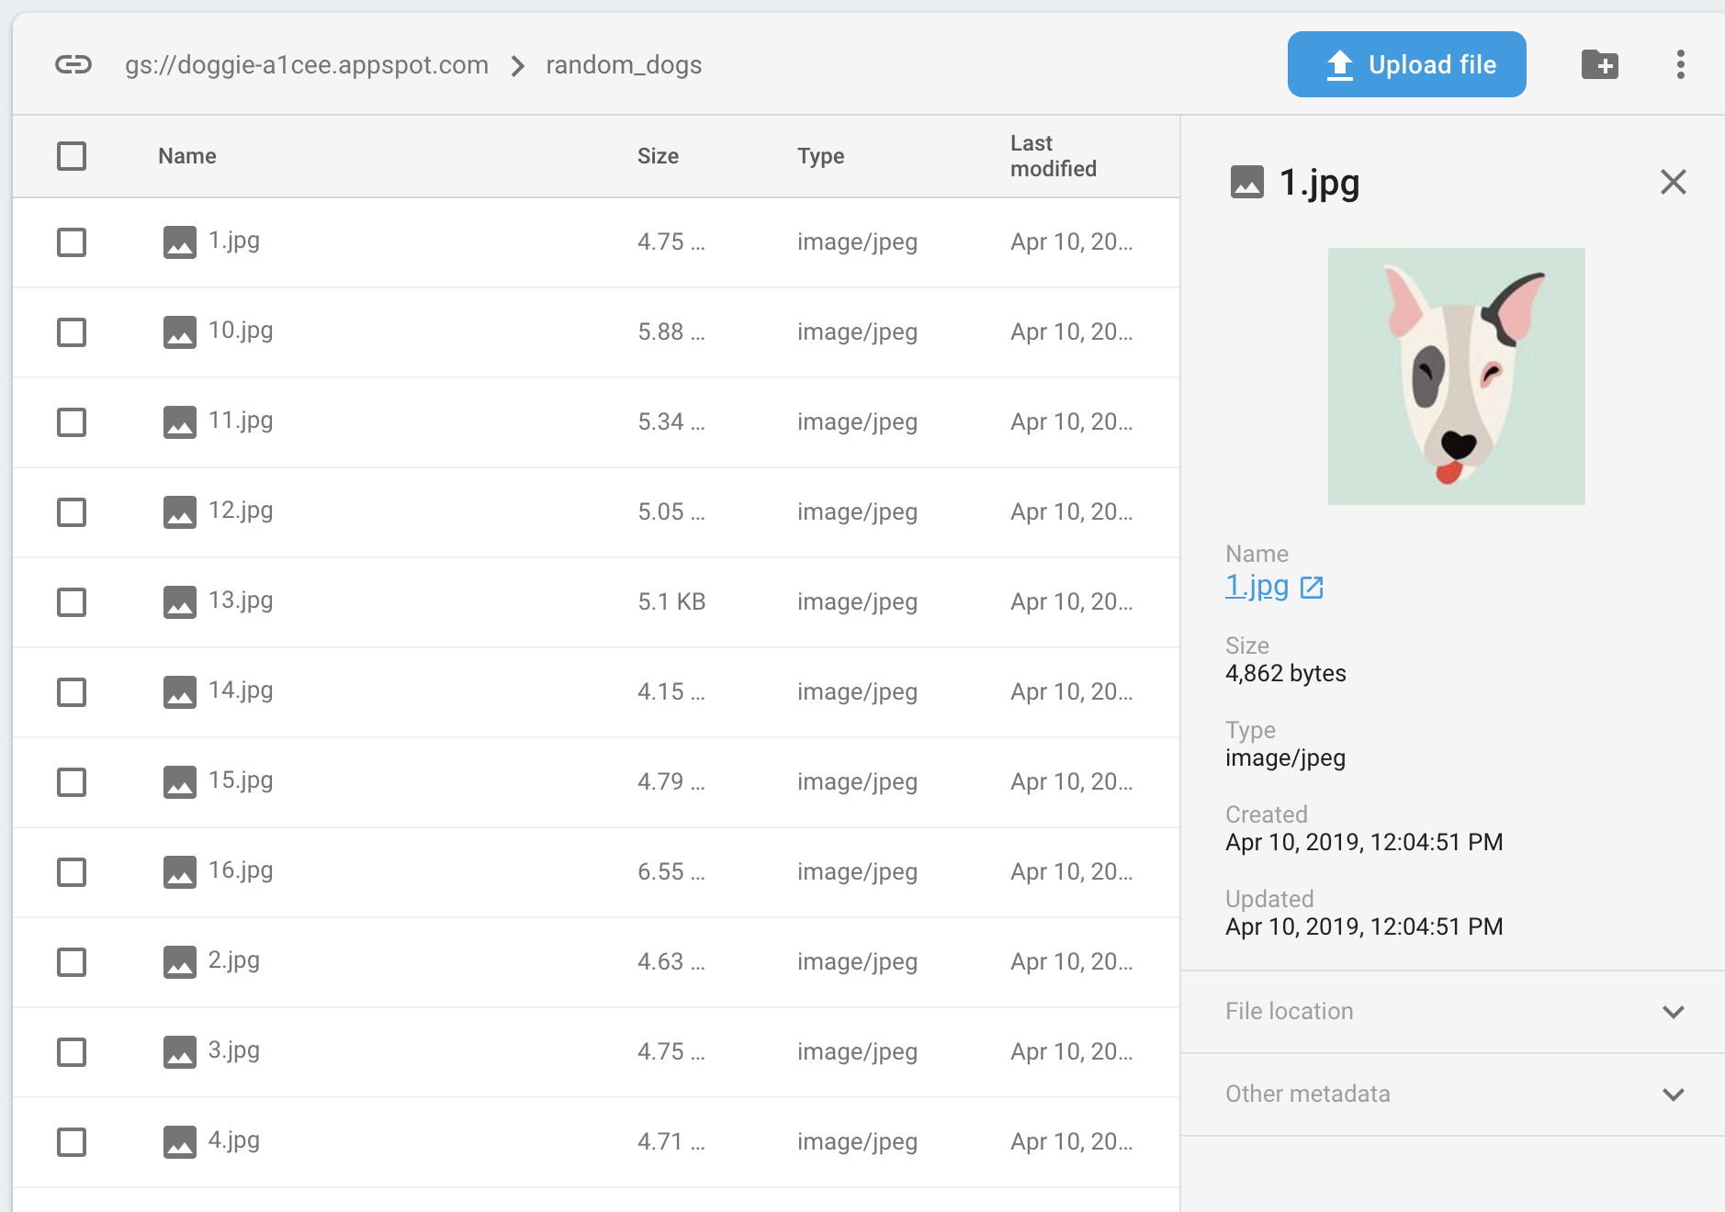
Google Services
Firebase
Authentication
Cloud Firestore
Storage
Google Maps

Slide 12
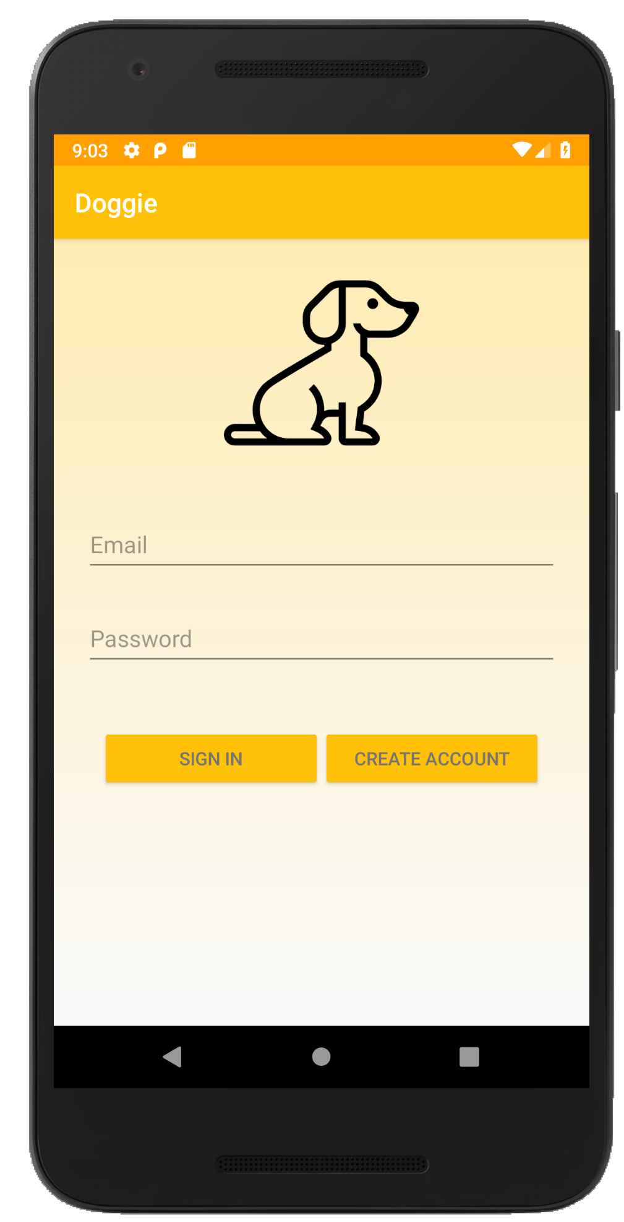
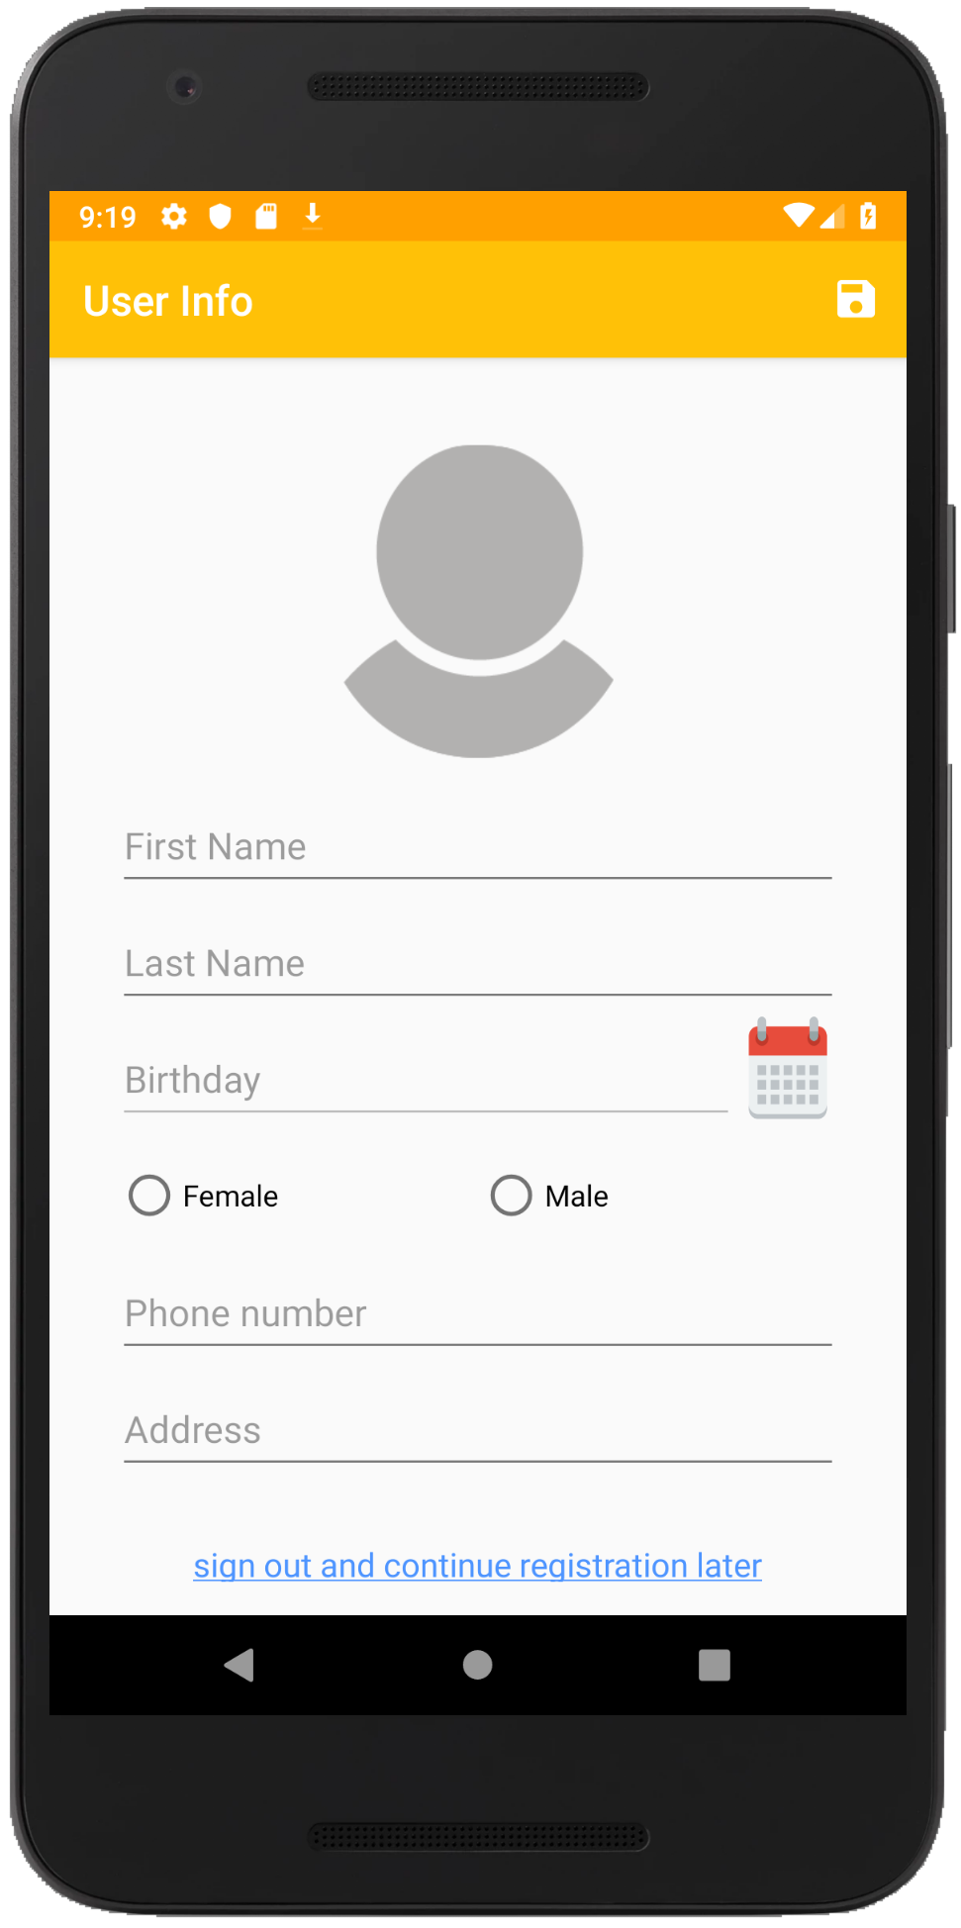
Features
Sign in/ create account

Slide 13
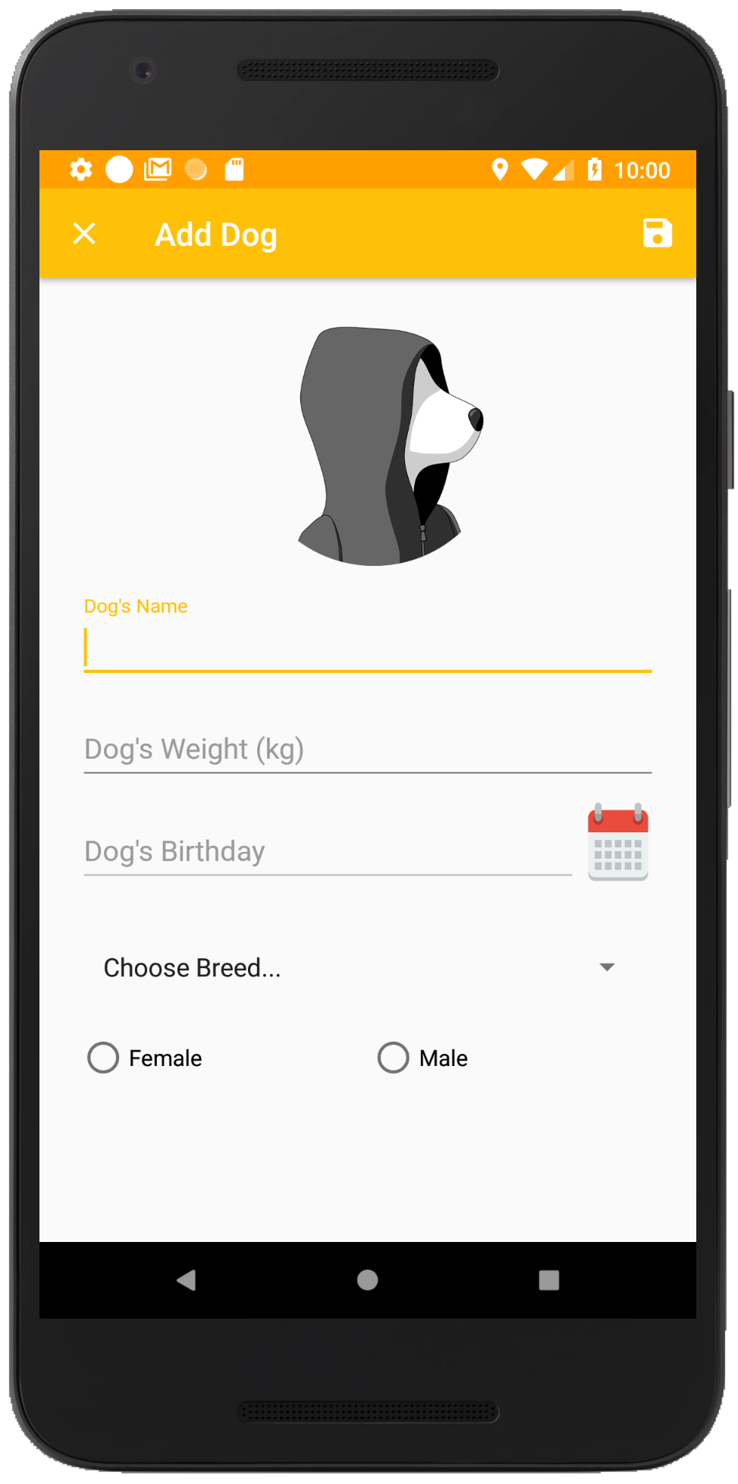
Features
Sign in/ create account
Add a new dog

Slide 14
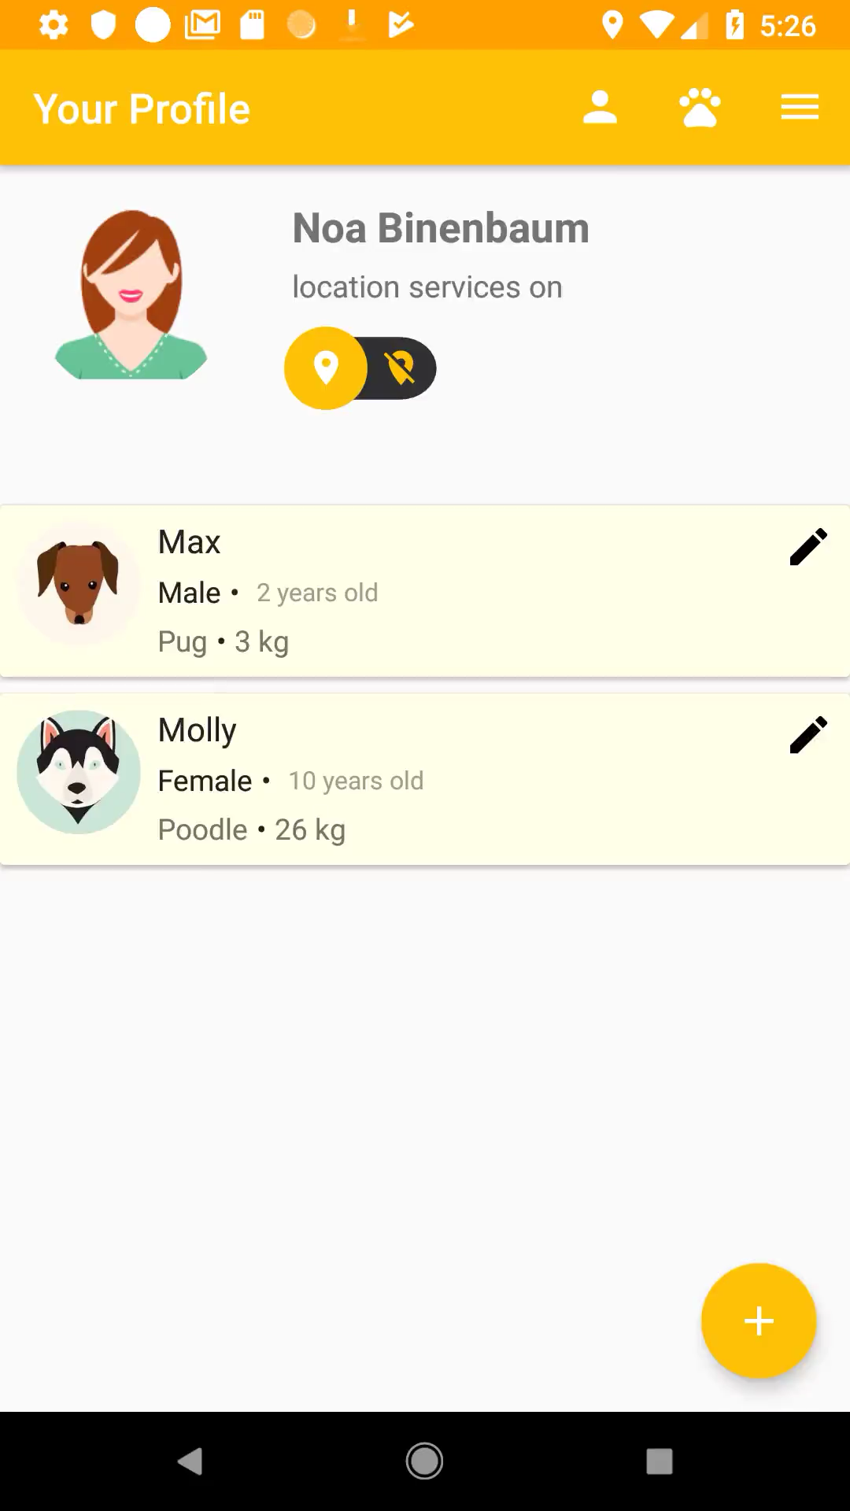
Features
Sign in/ create account
Add a new dog
Present user’s profile

Slide 15
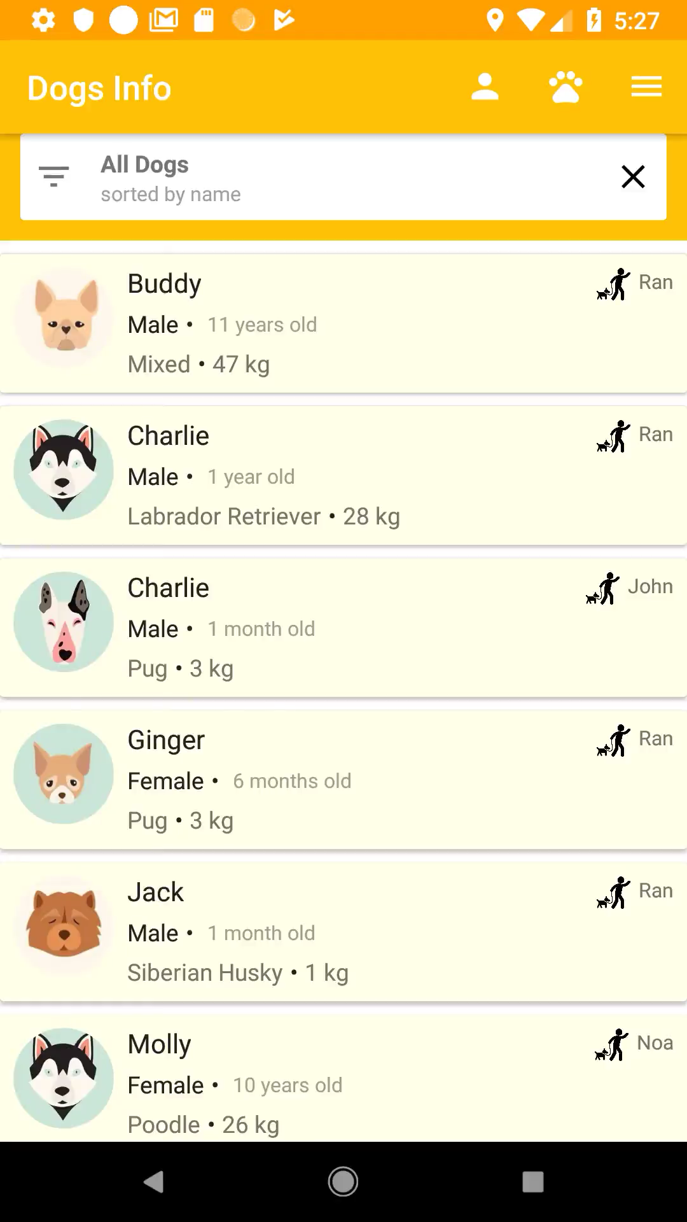
Features
Sign in/ create account
Add a new dog
Present user’s profile
Present all dogs

Slide 16
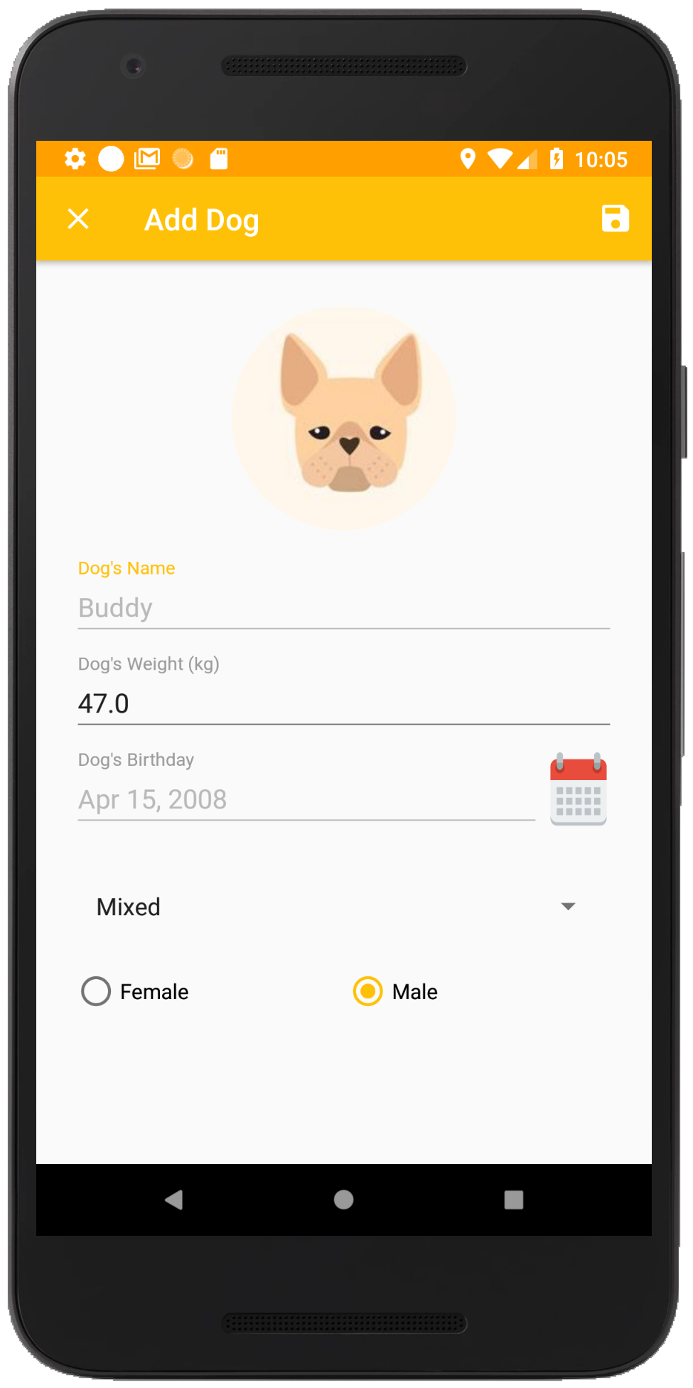
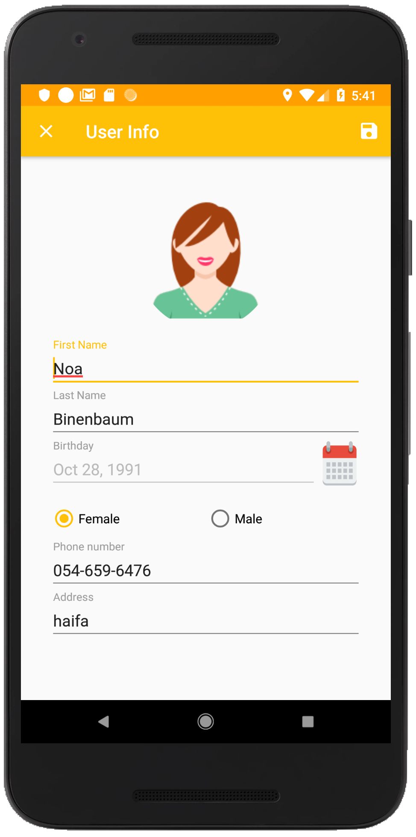
Features
Sign in/ create account
Add a new dog
Present user’s profile
Present all dogs
Edit profile

Slide 17
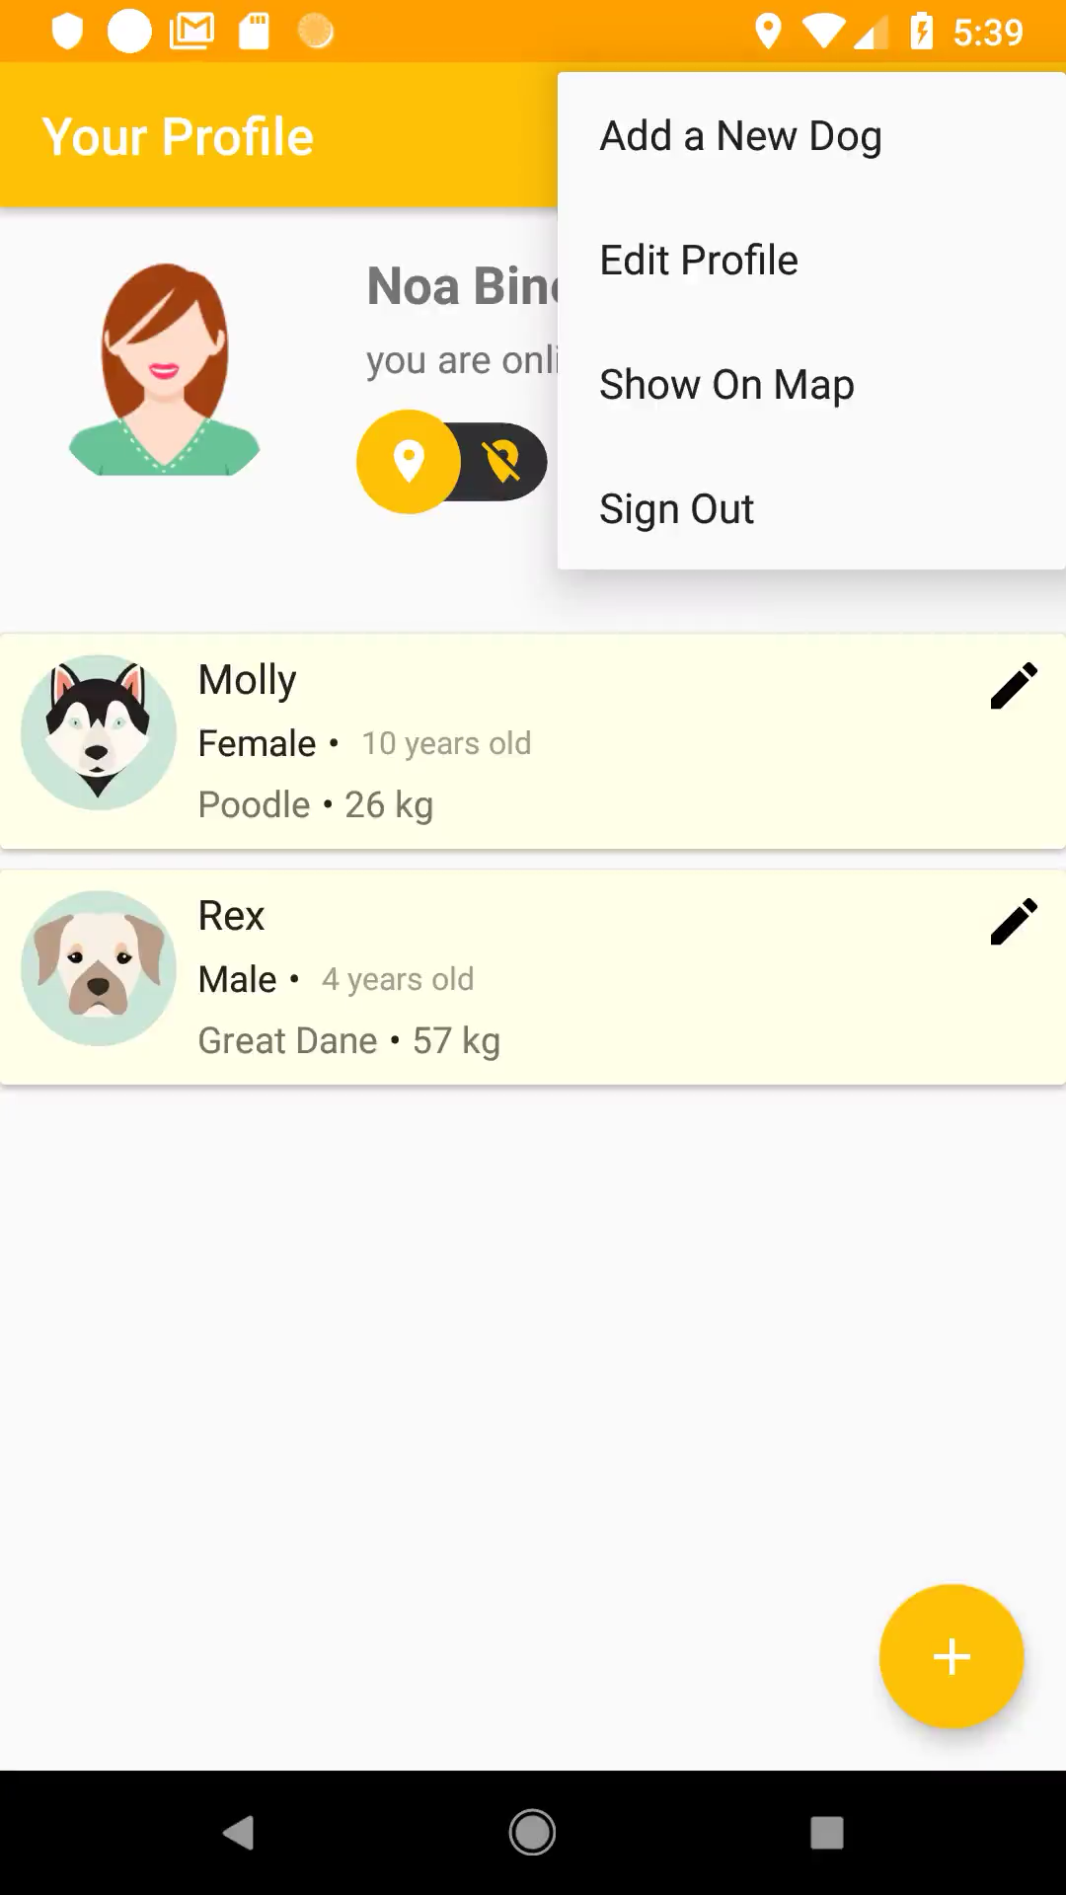
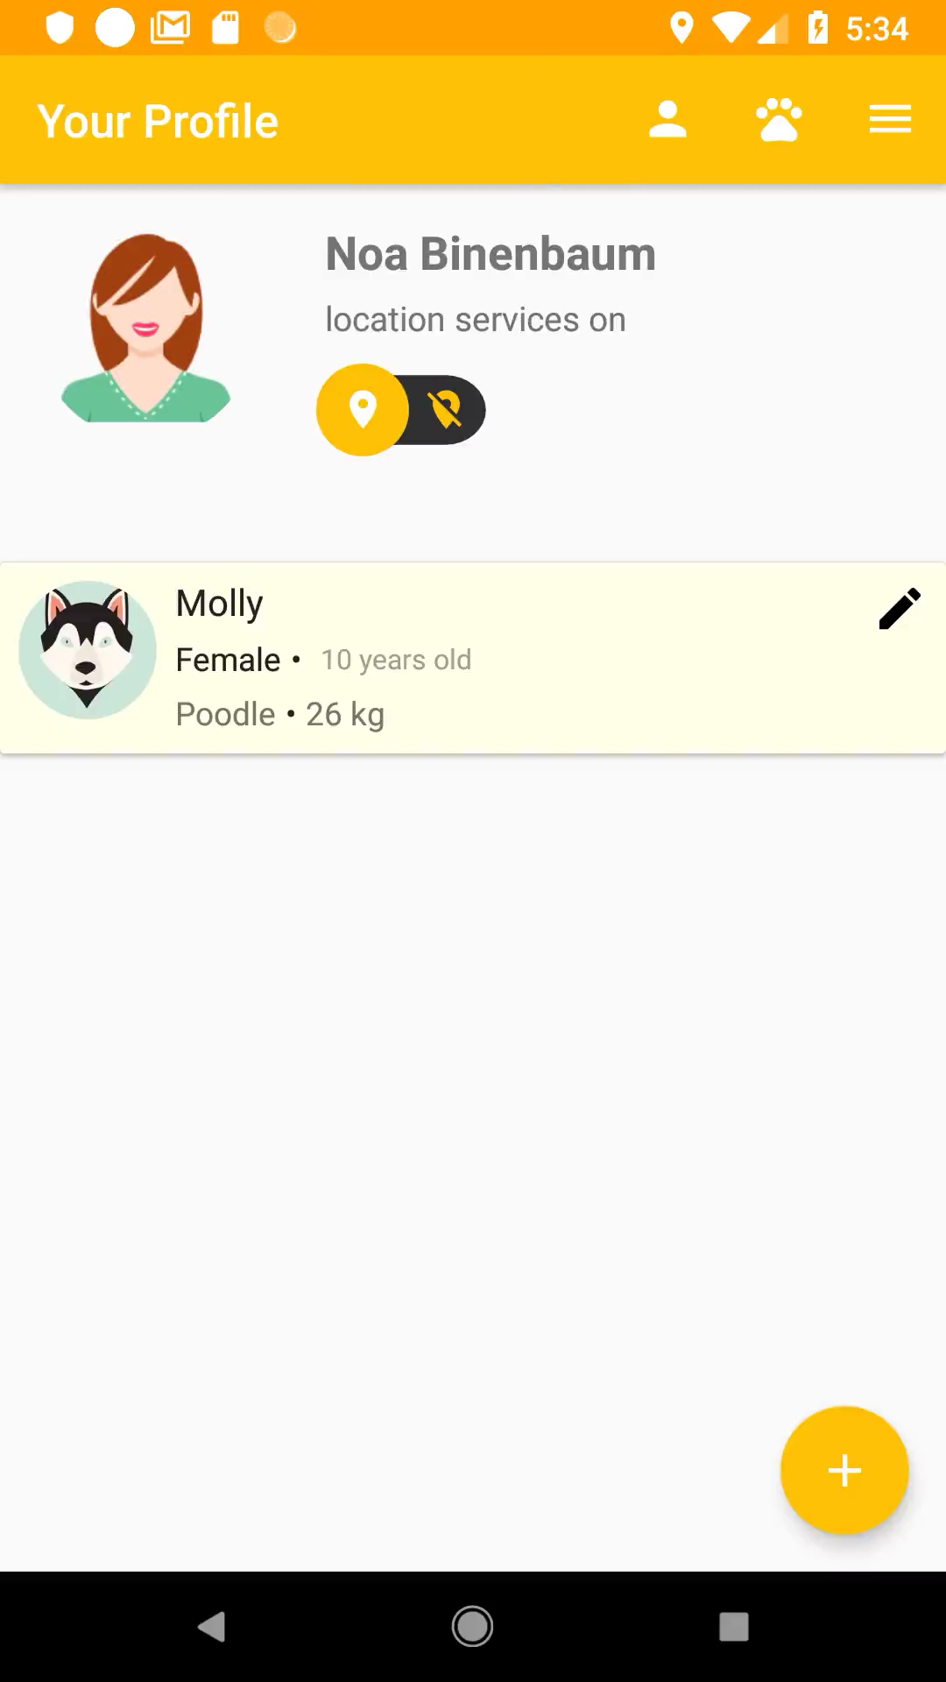
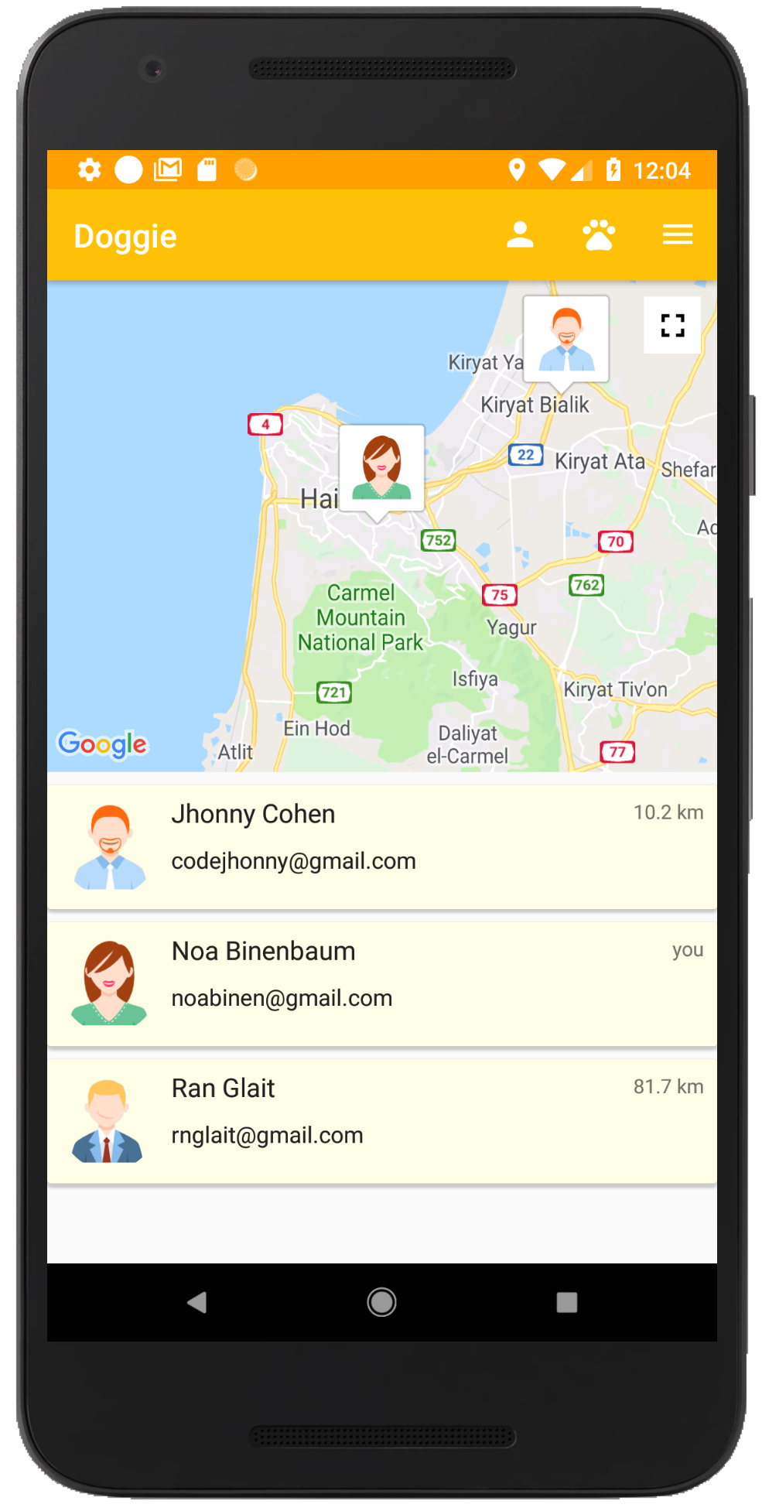
Features
Sign in/ create account
Add a new dog
Present user’s profile
Present all dogs
Edit profile
Show on map

Slide 18
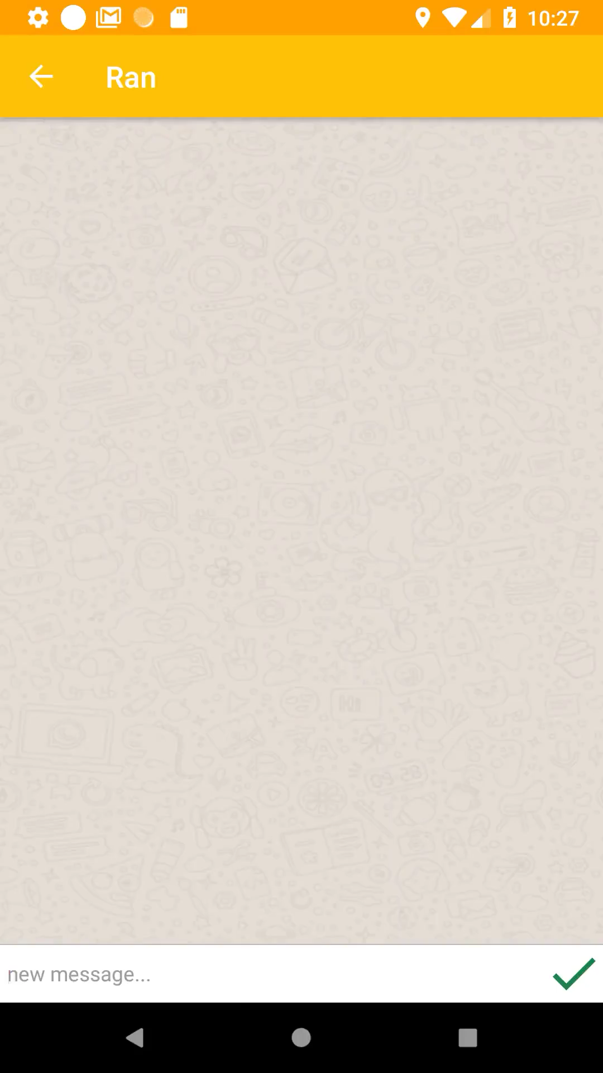
Features
Sign in/ create account
Add a new dog
Present user’s profile
Present all dogs
Edit profile
Show on map
Chat

Slide 19
Future Work
Integrating with other authentication methods such as Gmail, Facebook and twitter
Adding markers on map for potentially meeting places and ranking them
Notifications for received messages
Adding fields for more detailed descriptions of the dogs
Sharing status with favorite users only

Slide 20
Thank You!

